Slide 1
Analytical instrumentation Section-2, Ppt-26

Slide 2
NMR Spectroscopy (Nuclear Magnetic Resonance)

Slide 3
Introduction
Nuclear Magnetic Resonance (NMR) was first detected experimentally at the end of 1945,
The first NMR spectra was first published Physical Review in January 1946.
Bloch and Purcell were jointly awarded the 1952 Nobel Prize in Physics for their research of Nuclear Magnetic Resonance Spectroscopy.

Slide 4
Application of NMR
NMR spectroscopy is used to determine structure of proteins, aminoacid profile, carotenoids, organic acids, lipid fractions,
The mobility of the water in foods.
NMR spectroscopy is also used to identify and quantify the metabolites in foods

Slide 5
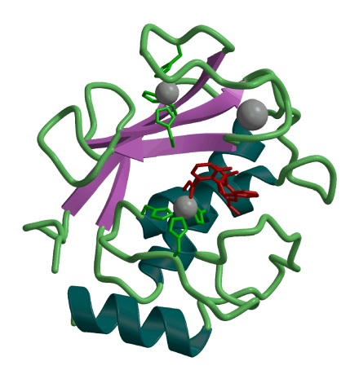
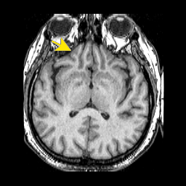
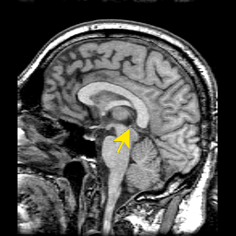
Typical Applications of NMR:
1.) Structural (chemical) elucidation
‚ Natural product chemistry
‚ Synthetic organic chemistry
- analytical tool of choice of synthetic chemists
- used in conjunction with MS and IR
2.) Study of dynamic processes
‚ reaction kinetics
‚ study of equilibrium (chemical or structural)
3.) Structural (three-dimensional) studies
‚ Proteins, Protein-ligand complexes
‚ DNA, RNA, Protein/DNA complexes
‚ Polysaccharides
4.) Metabolomics
5.) Drug Design
‚ Structure Activity Relationships by NMR
6.) Medicine -MRI
Taxol (natural product)
NMR Structure of MMP-13 complexed to a ligand
MRI images of the Human Brain

Slide 6
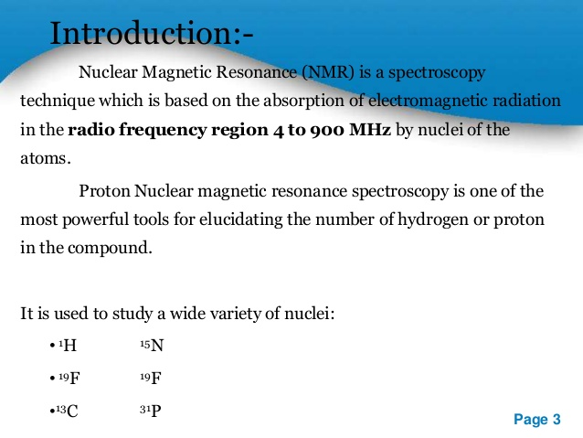

Slide 7
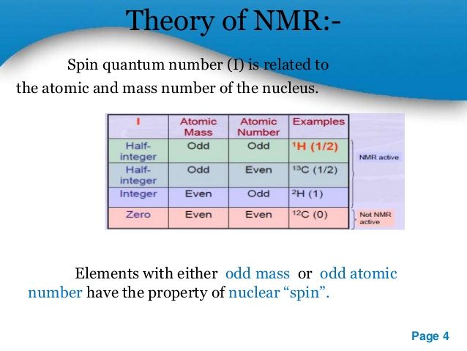

Slide 8
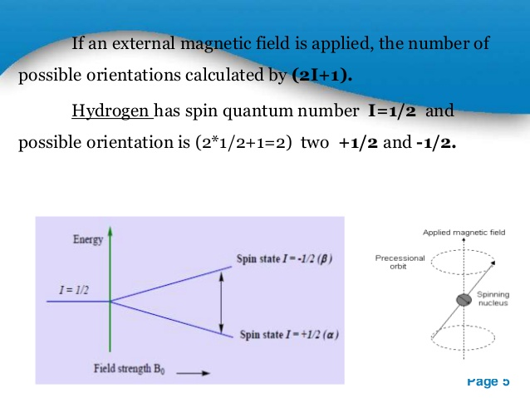

Slide 9
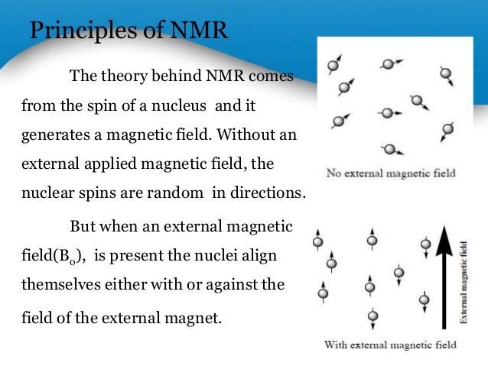

Slide 10
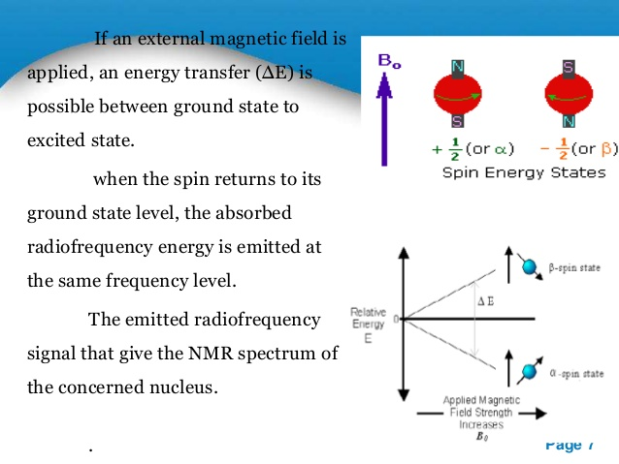

Slide 11
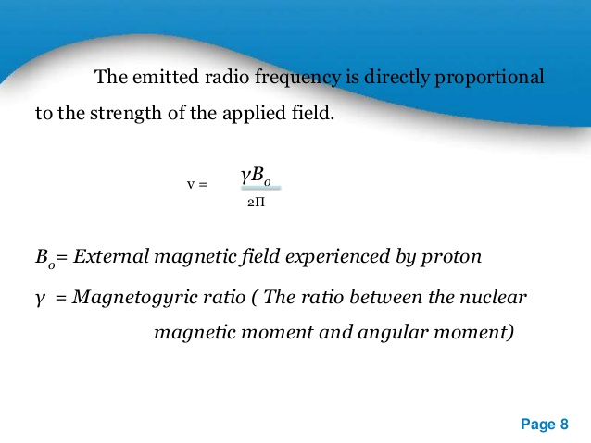

Slide 12
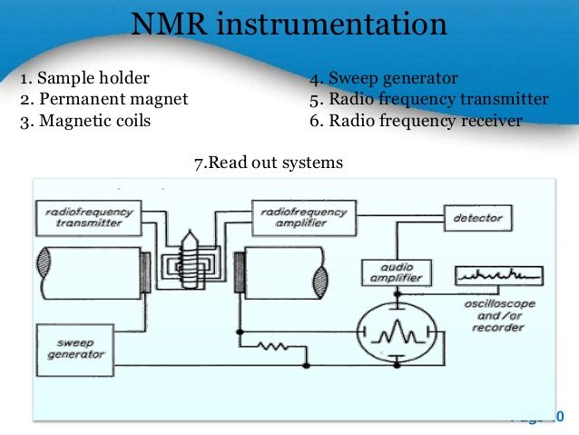

Slide 13
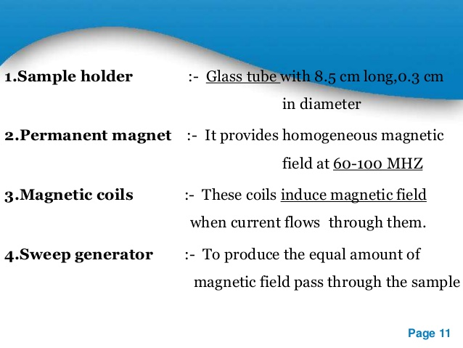

Slide 14
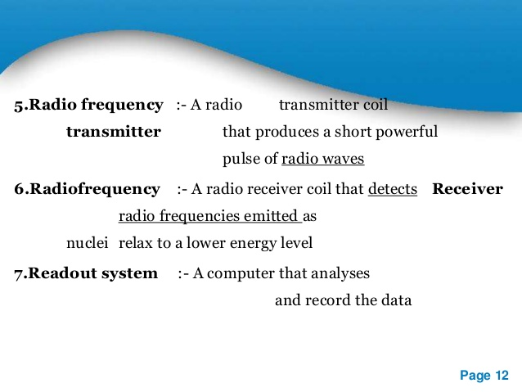

Slide 15
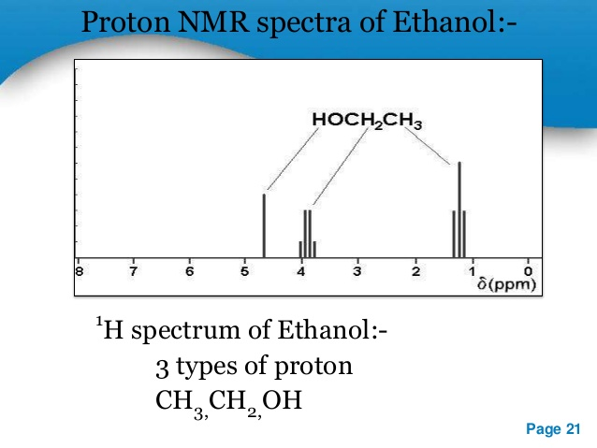

Slide 16
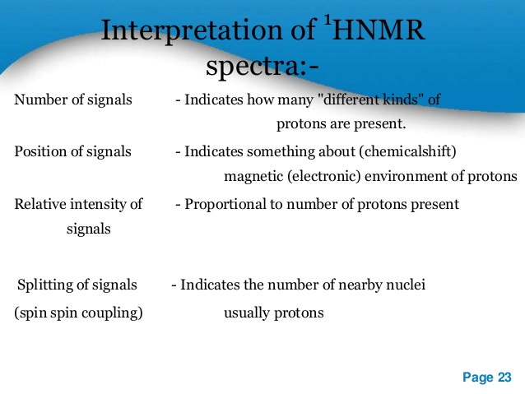

Slide 17
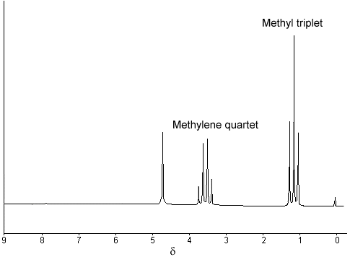
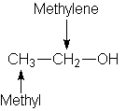

Slide 18
Thank you

